Slide 1
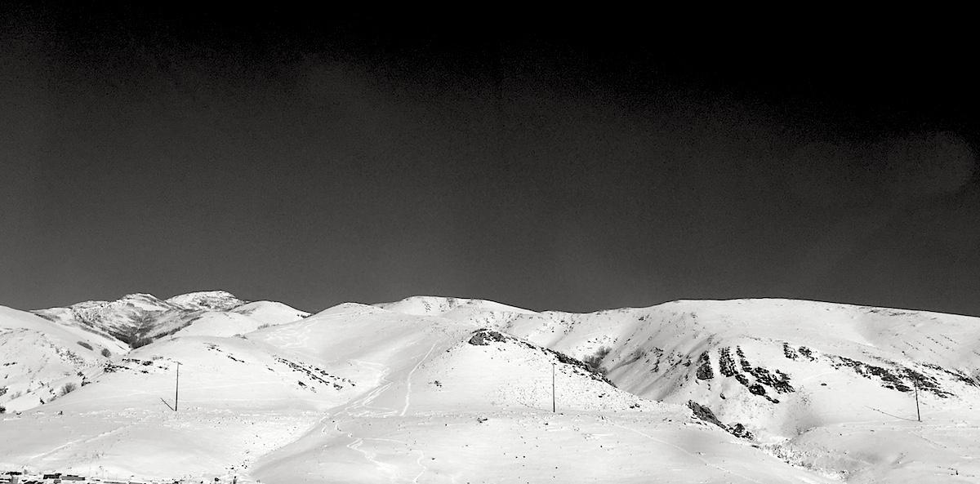
Poisson processes in biology.
https://github.com/quinlan-lab/applied-computational-genomics
Aaron Quinlan
Departments of Human Genetics and Biomedical Informatics
USTAR Center for Genetic Discovery
University of Utah
quinlanlab.org

Slide 2
HW3
https://gist.github.com/arq5x/c0eb84bce2086fbfbe9184668ef87b31#file-hw3-2024-md
Due 11:59 on Thurs, Feb 29

Slide 3
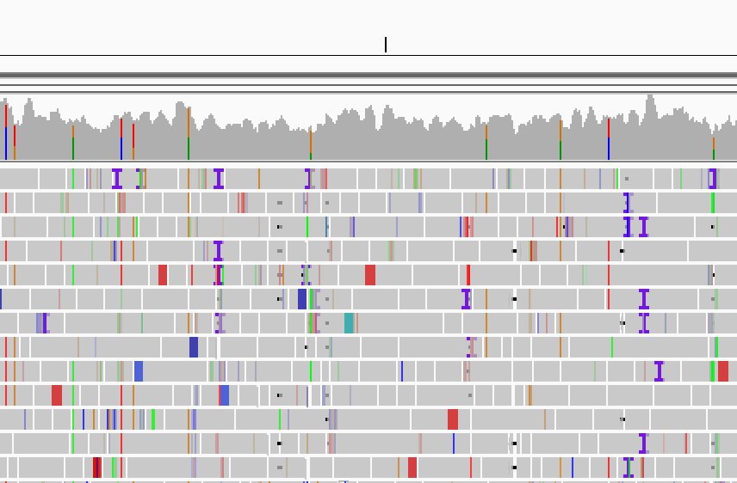
Depth of aligned sequence is variable
Depth =22
Depth =32
Depth =40
Depth =20

Slide 4
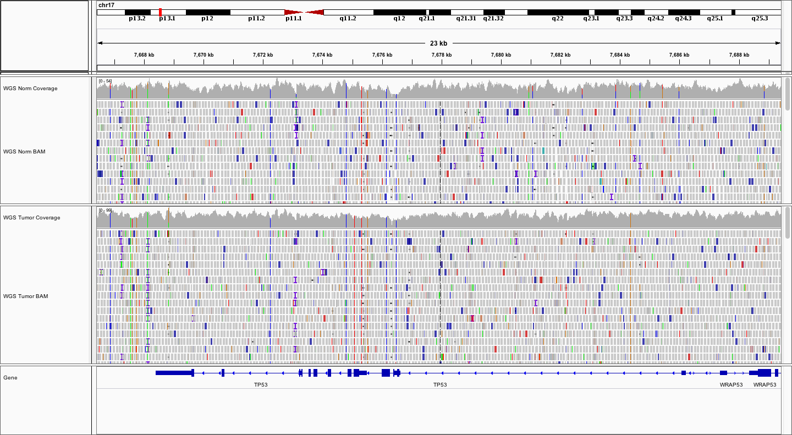
What accounts for variability in depth?

Slide 5
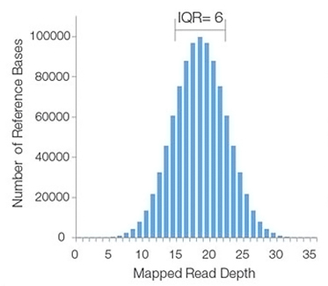
What accounts for variability in depth?

Slide 6
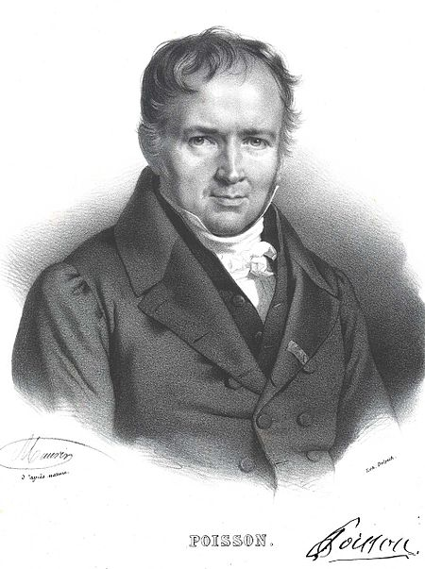
Siméon-Denis Poisson
French mathematician, engineer, physicist (1781 – 1840)
One of 72 scientists whose name is on the Eiffel tower.
>300 publications on math, physics, and astronomy
Creator of the Poisson distribution. Incredibly useful in science for cases where we need to count and model random events

Slide 7
The Poisson distribution is used to describe the distribution of rare events in a large population. For example, at any particular time, there is a certain probability that a particular cell within a large population of cells will acquire a mutation.
A Poisson process is appropriate here because mutation acquisition is a rare event, and each mutation event is independent of one another.
https://www.sciencedirect.com/topics/biochemistry-genetics-and-molecular-biology/poisson-distribution

Slide 8
Poisson Process
Useful model when counting the occurrences of events that appear to happen at a certain rate, but at random.
Let's say that there is 1 earthquake above 6.0 worldwide per month, on average.
0
0
2
0
1
1
0
3
0
0
0
2
1
1
1
1
0
1
1
0
3
3
1
2
2
1
0
1
0
0
1
3
Month 1
Month 32
Important requirement: the number of events per time period are independent.

Slide 9
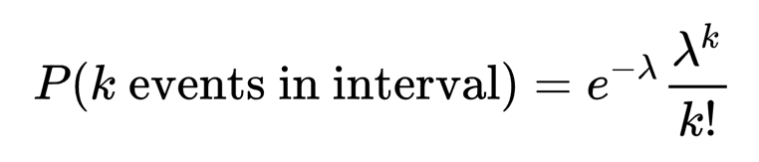
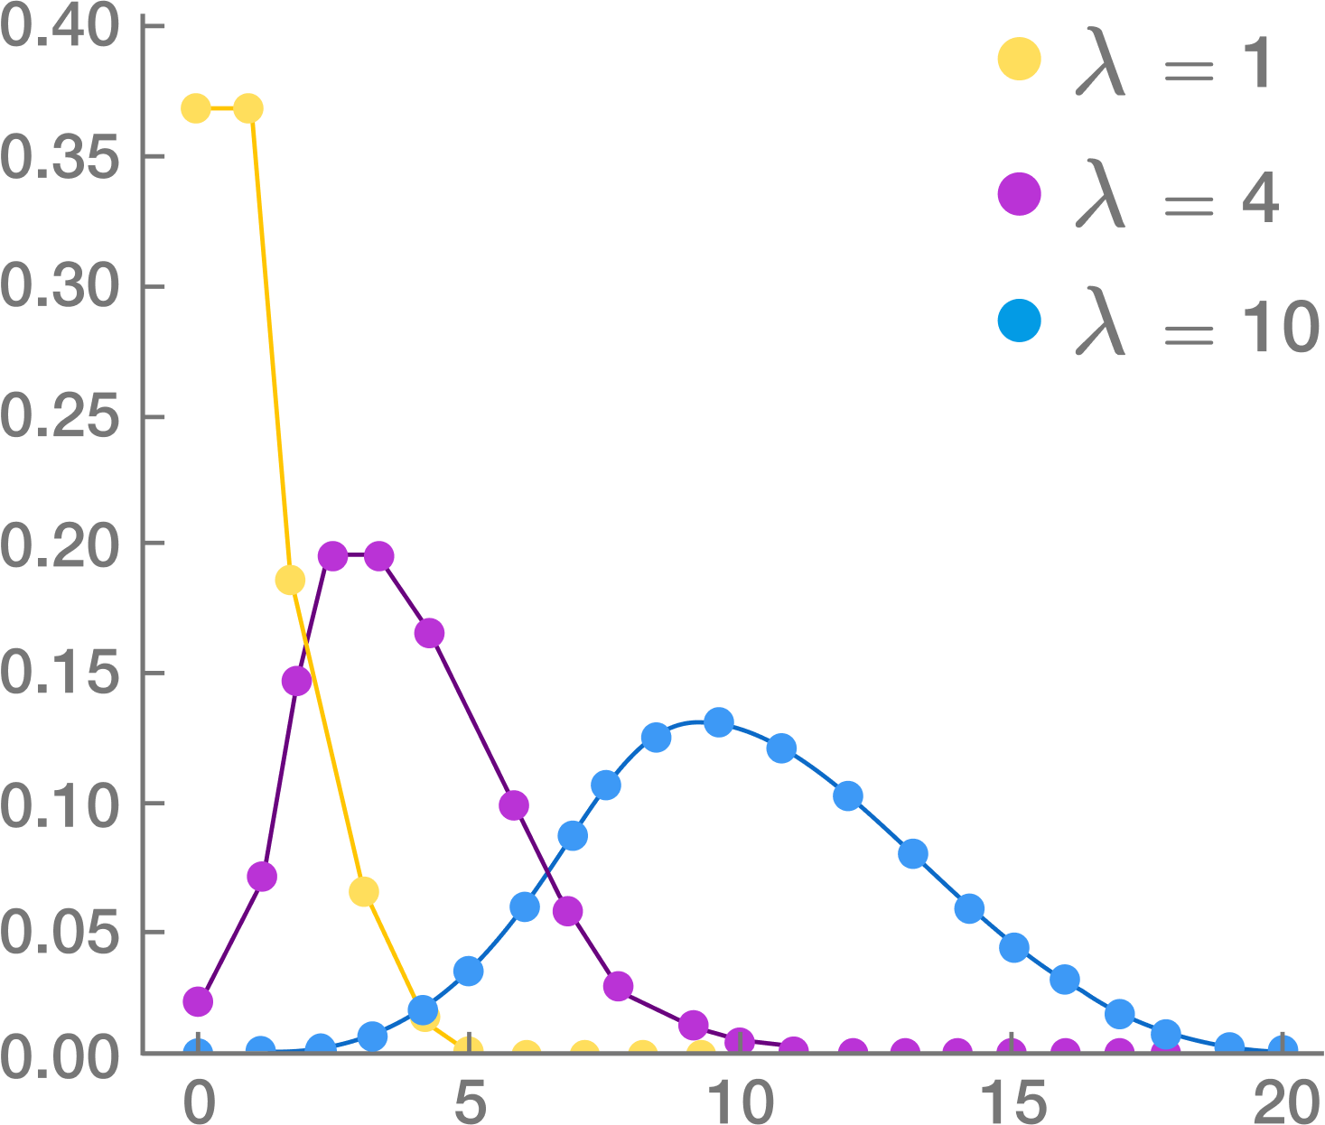
Poisson Distribution. One parameter. Lambda
Expresses the probability of a given number of events occurring in a fixed interval of time or space if these events occur with a known constant rate
P(2 earthquakes in one month) = e⁻²(1²/2!)
# Plug lambda and k into the equation
1^2 * exp(-1) / factorial(2)
[1] 0.1839397
# Shortcut (dpois)
dpois(x=2,lambda=1)
[1] 0.1839397

Slide 10
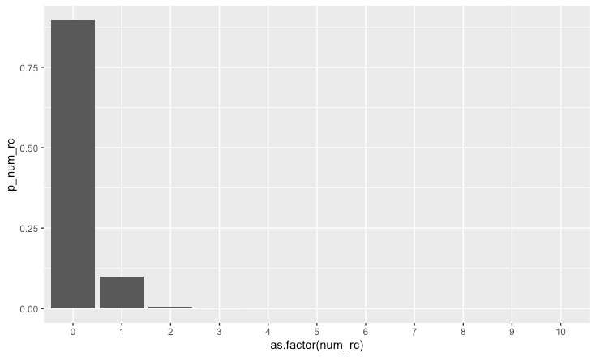
How many red cards do we expect in an English Premier League game?
Average of 0.11 bookings per game in the 2018/2019 season.
# install.packages("ggplot2")
library(ggplot2)
num_rc <- 0:10
p_num_rc <- dpois(0:10, lambda=0.11)
rc_prob = data.frame(num_rc, p_num_rc)
ggplot(rc_prob, aes(x=as.factor(num_rc), y=p_num_rc)) +
geom_col()
https://www.gambling.com/online-betting/strategy/8-essential-premier-league-stats-10400

Slide 11
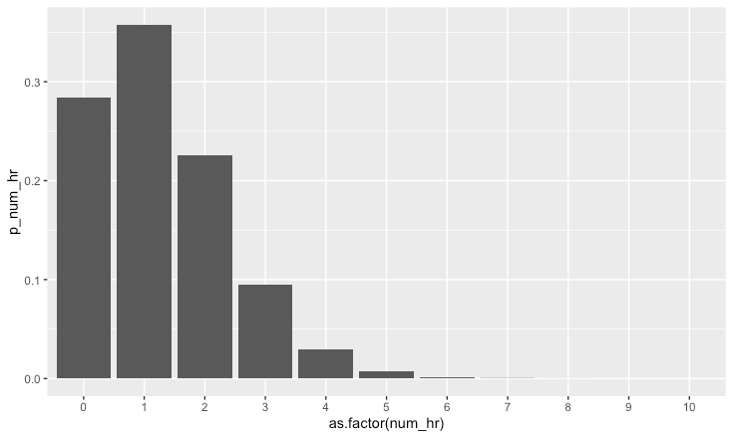
How many home runs do we
expect in a Major League Baseball game?
Average #home runs in 2017
was 1.26 (a record).
library(ggplot2)
num_hr <- 0:10
p_num_hr <- dpois(0:10, lambda=1.26)
home_run_prob = data.frame(num_hr, p_num_hr)
ggplot(home_run_prob, aes(x=as.factor(num_hr), y=p_num_hr))
+ geom_col()
https://www.boston.com/sports/mlb/2019/05/02/mlb-home-runs-strikeouts-record

Slide 12
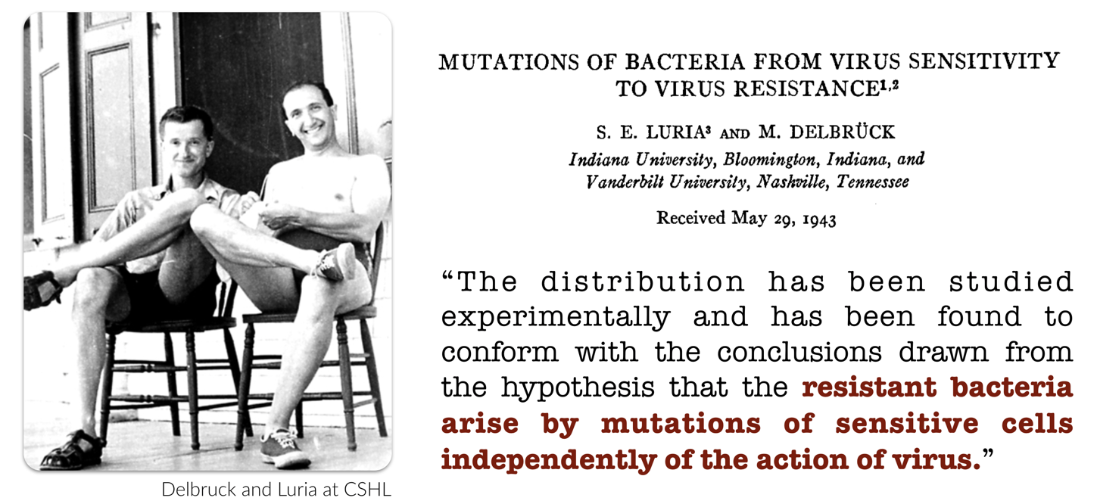
Luria-Delbruck experiment
How do phage-resistant bacteria colonies arise?
Do resistant mutations arise under pressure from phage or did they prexist?
In other words, genetic mutations arise in the absence of selection, rather than being acquired in response to selection.
https://en.wikipedia.org/wiki/Luria%E2%80%93Delbr%C3%BCck_experiment
Notes:
"Assuming a constant rate of mutation, Luria hypothesized that if mutations occurred after and in response to exposure to the selective agent, the number of survivors would be distributed according to a Poisson distribution with the mean equal to the variance. This was not what Delbrück and Luria found: Instead the number of resistant colonies on each plate varied drastically: the variance was considerably greater than the mean."

Slide 13
Mutations at autosomal nucleotide sites are roughly 10⁻⁹ per year.
Consider a position in your genome. If you could trace its ancestry back across the last 10⁹ years, what is the probability that you would find no mutations?
The expected number of mutations is λ = ut, where u = 10⁻⁹ and t = 10⁹. Thus, λ = 1. The probability of no mutations at the site you chose is:
1^0 * exp(-1) / factorial(0)
[1] 0.3678794
dpois(x=0,lambda=1)
[1] 0.3678794
What about the probability of one or more mutations?
Alan Rogers

Slide 14
An intro to ggplot2
Slides: https://docs.google.com/presentation/d/1T2KTEdk1h18oxic728BqI4UvW6P0OZyvP7VUZKXsM8E/edit
Video:
https://youtu.be/4G4mvSWvwWo

Slide 15
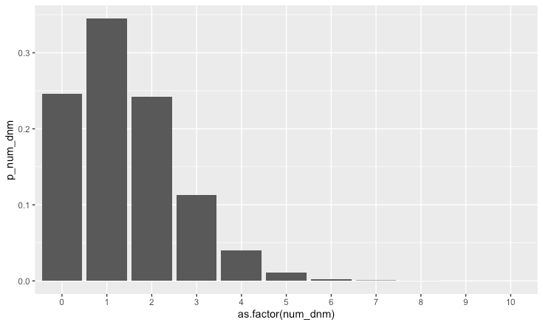
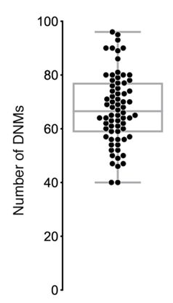
How many coding, de novo mutations do we expect per exome?
What is the probability of 1 or more coding mutations?
70.1 de novo
mutations / offspring
genome-wide
X 0.02
(exome is ~2% of genome)
= 1.402
biorxiv.org/content/10.1101/552117v2.full
library(ggplot2)
num_dnm <- 0:10
p_num_dnm <- dpois(0:10, lambda=1.402)
dnm_prob = data.frame(num_dnm, p_num_dnm)
ggplot(dnm_prob, aes(x=as.factor(num_dnm), y=p_num_dnm)) +
geom_col()

Slide 16

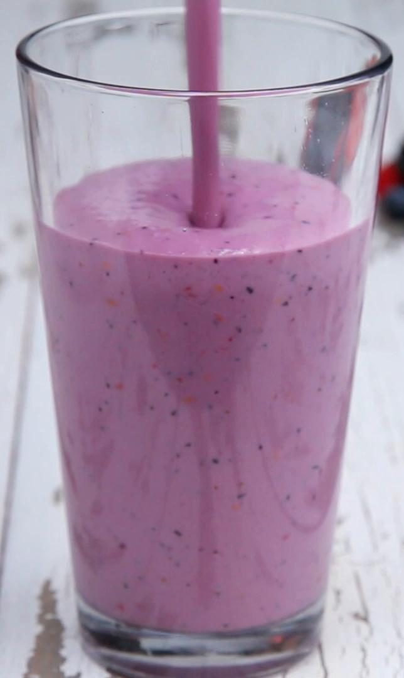
Bulk RNA expression
Single-cell RNAseq
Bulk RNAseq

Slide 17
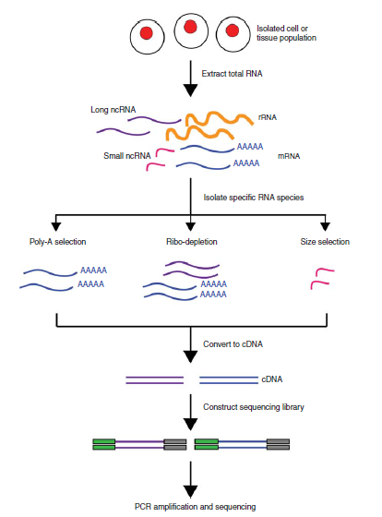
Poisson in differential (bulk) RNA expression
# Simulate 10,000 genes
N_genes = 10000
# Simulate a range of 10000 mean
# genes expression values (lambda) of each of the 10000 genes.
lambdas = seq(1,1024,len=N_genes) #creates 10000 evenly-spaced numbers
# between 1 and 1024
# Simulate two technical replicates for an RNA-seq
# experiment. The observed expression for each of the
# 10,000 genes will be sampled from a Poisson distribution
# using the same lambda assigned to the gene for each
# replicate.
rep1 = rpois(N_genes, lambdas)
rep2 = rpois(N_genes, lambdas)
# remove genes where the expression was 0 in either rep.
non_zero = which(rep1>0 & rep2>0)
lambdas = lambdas[non_zero]
rep1 = rep1[non_zero]
rep2 = rep2[non_zero]
# make a data frame of lambdas and expression from replicates
rna_sim = data.frame(lambdas, rep1, rep2)
https://www.youtube.com/watch?v=KuxRYdG1EdQ

Slide 18
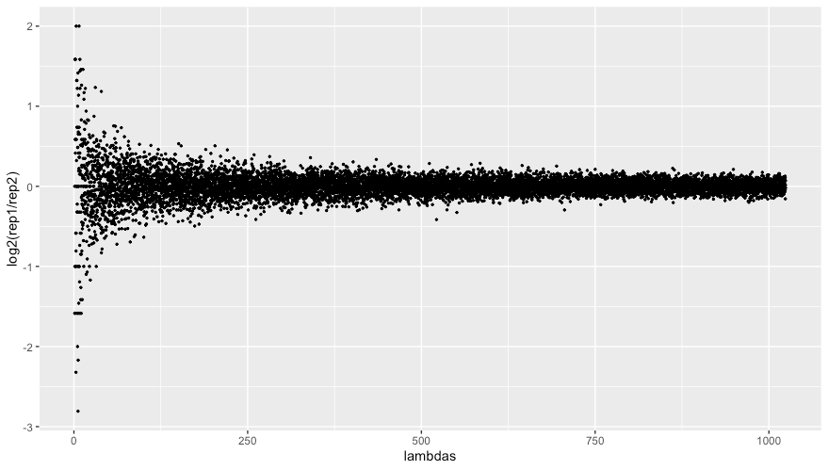
Sources of variance. Poisson (counting) noise
# plot the expression ratio from the two replicates as a function of # the mean expression for the gene (lambda)
# plot in log2 space for better separation of the data
library(ggplot2)
ggplot(rna_sim, aes(x=lambdas, y=rep1/rep2)) + geom_point(size=0.5)
Far greater random or "technical" variation in genes with low expression
Expected frequency
Number of events
https://www.youtube.com/watch?v=KuxRYdG1EdQ

Slide 19
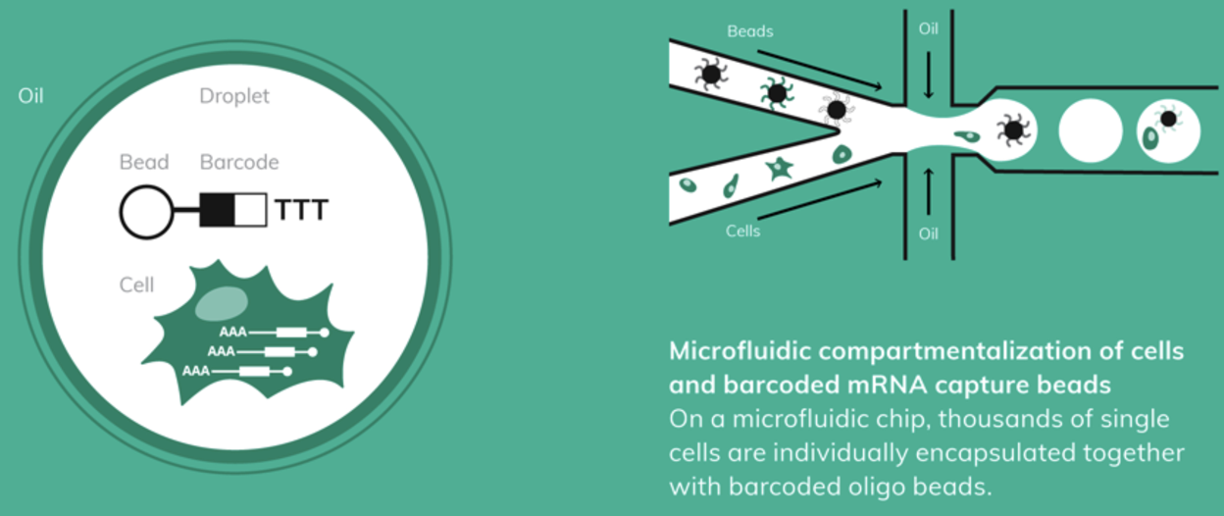
Drop-seq (single cell sequencing in droplets)
https://www.dolomite-bio.com/wp-content/uploads/Drop-Seq-Workflow.png

Slide 20
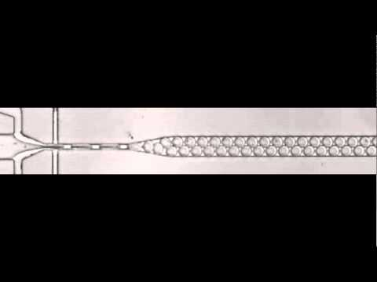
Drop-seq (single cell sequencing in droplets)
https://www.youtube.com/watch?time_continue=3&v=usK71SG30t0

Slide 21
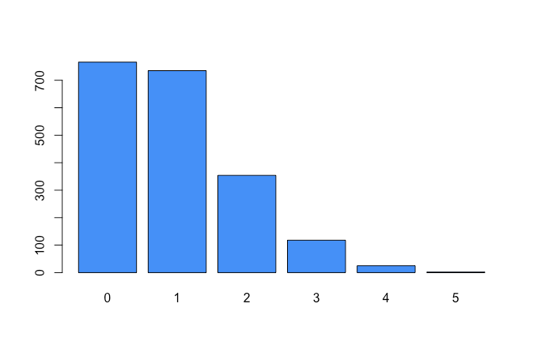
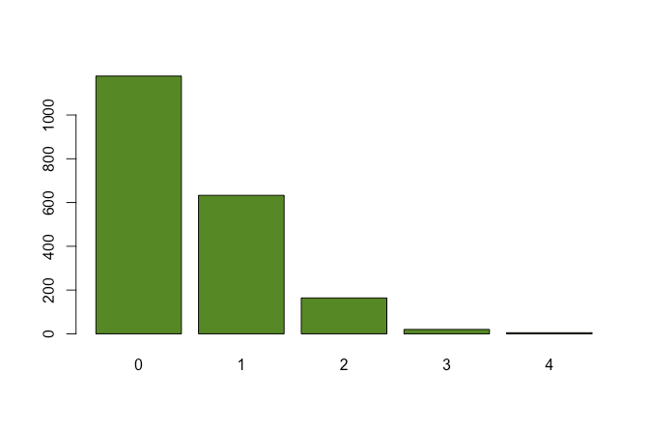
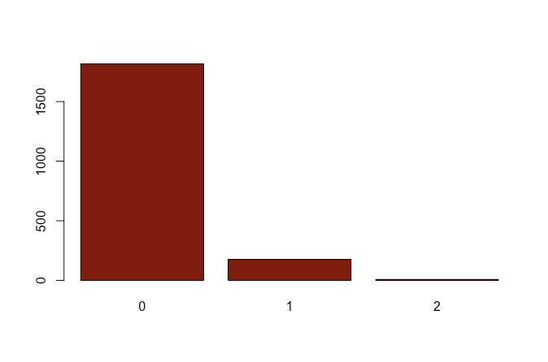
Goal: one cell per droplet
Should one load shooting for an average of one cell per droplet (lambda = 1)?
Let's simulate.
What about (lambda = 0.5)?
What about (lambda = 0.1)?
sc_sim <- rpois(2000, lambda=1)
barplot(table(sc_sim), col="dodgerblue")
sc_sim <- rpois(2000, lambda=0.5)
barplot(table(sc_sim), col="chartreuse4")
sc_sim <- rpois(2000, lambda=0.1)
barplot(table(sc_sim), col="darkred")
Lot's of droplets with >1 cell.
"doublets", "triplets".
What fraction are expected to
be this way?
Better, but still many cells with >1 cell.
> dpois(x=1, lambda=0.1)
[1] 0.09048374
> 0.09048374 * 2000
[1] 180.9675

Slide 22
Goal: one cell and one bead per droplet
Lamdba = 0.1 to minimize
>1 cell per droplet
Lamdba = 0.1 to minimize
>1 bead per droplet
> dpois(x=1, lambda=0.1)
[1] 0.09048374
X
> dpois(x=1, lambda=0.1)
[1] 0.09048374
=
0.0081

Slide 23
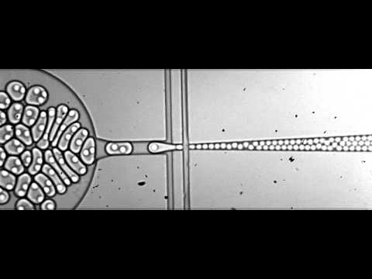
Why is single-cell "sub-Poisson"?
https://liorpachter.wordpress.com/2019/02/07/sub-poisson-loading-for-single-cell-rna-seq/
“the close packing of hydrogel beads [in 10x or inDrops] can be said to enable sub-Poisson loading of beads into droplets because the variance of beads per droplet is reduced in comparison to the Poisson statistics of plastic beads.” Drop-seq has a ~2-3% cell capture rate while the other two are more like 25-50%

